Slide 1
Welcome & Setting the Stage, Keynote, Plenary
June 6
Hosted by Sidley Austin LLP

Slide 2
Welcome & Setting the Stage
Edward McNicholas, Sidley Austin, National Law Center on Homelessness & Poverty Board
Robert Warren, People for Fairness Coalition, National Law Center on Homelessness & Poverty Board, Planning Committee Co-Chair
Maria Foscarinis, National Law Center on Homelessness & Poverty

Slide 3
Plenary: The election and what it means for our work and the Housing Not Handcuffs Campaign
Panelists will share their thoughts and answer questions on the impact of the new Administration and Congress on housing, homelessness, and criminal justice advocacy, and how we can best adjust our strategies to still make progress with the national and local goals of the Housing Not Handcuffs Campaign.

Slide 4
Plenary: The election and what it means for our work and the Housing Not Handcuffs Campaign
Moderator:
Janet Hostetler, National Law Center on Homelessness & Poverty
Panelists:
Chiraag Bains, Harvard University Law School
Don Saunders, National Legal Aid & Defender Association
Diane Yentel, National Low Income Housing Coalition

Slide 5
Plenary: Lessons from Recent Wins at the State and Local Level
Panelists will share recent victories and how they achieved them, including Indianapolis’ law requiring adequate housing be provided prior to the eviction of a homeless encampment, Los Angeles’ approval of a new tax to fund affordable housing, creative work going on across the country using smart data (and smart policies) to reduce the overuse of criminal justice on chronically homeless persons, and victories in the courts fighting criminalization of homelessness.

Slide 6
Plenary: Lessons from Recent Wins at the State and Local Level
Moderator:
Eric Tars, National Law Center on Homelessness & Poverty
Panelists:
Lynn Overmann, Arnold Foundation
Sam Petsonk, Mountain State Justice
Don Sawyer, A Bigger Vision
Pete White, LA Community Action Network

Slide 7
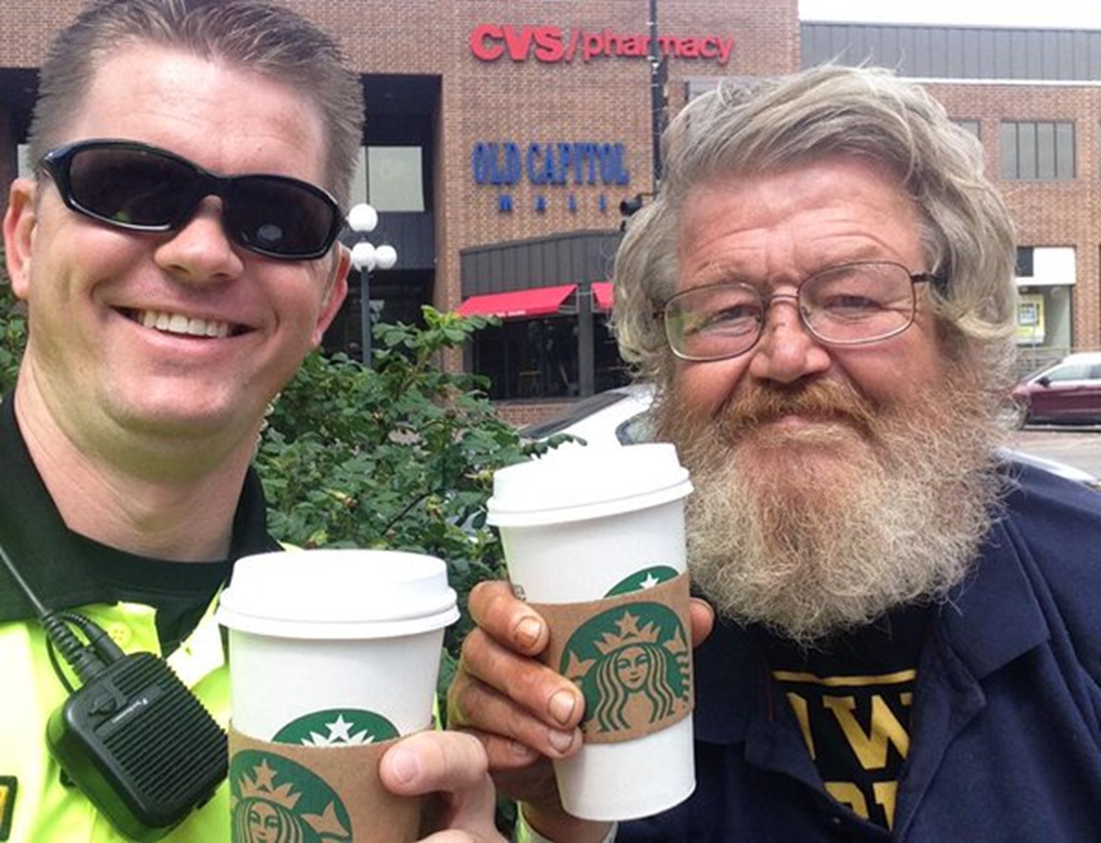
Plenary: Lessons from Recent Wins at the State and Local Level

Slide 8
Lunch and Keynote
Catherine Lhamon, Chair, U.S. Commission on Civil Rights
Catherine E. Lhamon is the Chair of the U.S. Commission on Civil Rights. President Obama appointed Lhamon to a six-year term on the Commission in December 2016. Before coming to the Commission, Lhamon served as the Assistant Secretary for Civil Rights at the U.S. Department of Education from 2013-2017. Immediately prior to joining the Department of Education, Lhamon was director of impact litigation at Public Counsel, the nation’s largest pro bono law firm. Before that, she practiced for a decade at the ACLU of Southern California, ultimately as assistant legal director. Earlier in her career, Lhamon was a teaching fellow and supervising attorney in the Appellate Litigation Program at Georgetown University Law Center, after clerking for The Honorable William A. Norris on the United States Court of Appeals for the Ninth Circuit. In 2016, Politico Magazine named Lhamon one of Politico 50 Thinkers Transforming Politics and the National Action Network honored Lhamon with their Action & Authority Award. In 2015, Yale Law School named Lhamon their Gruber Distinguished Lecturer and the Association of University Centers on Disabilities awarded Lhamon their Special Recognition Award. Chronicle of Higher Education named Lhamon to their 2014 Influence List as the Enforcer. The Daily Journal listed her as one of California’s Top Women Litigators in 2010 and 2007, and as one of the Top 20 California Lawyers Under 40 in 2007. In 2004, California Lawyer magazine named Lhamon Attorney of the Year for Civil Rights. Lhamon received her J.D. from Yale Law School, where she was the Outstanding Woman Law Graduate, and she graduated summa cum laude from Amherst College.

Slide 9
Plenary: Widening the Lens: Criminalization of Homelessness and Intersectionality
Homelessness falls disproportionately on persons of color, persons with disabilities, LGBTQ individuals (particularly LGBTQ youth), and other marginalized communities. Moreover, discrimination based on racial, ethnic and gender identity, sexual orientation, and/or disability contributes to and exacerbates criminalization based on homelessness. This panel will explore the intersections of status and identities and discuss how an intersectional analysis informs how advocates work together.

Slide 10
Plenary: Widening the Lens: Criminalization of Homelessness and Intersectionality
Moderator:
Tristia Bauman, National Law Center on Homelessness & Poverty
Panelists:
Janae Bonsu, Black Youth Project 100
Marc Dones, Center for Social Innovation
Meghan Maury, National LGBTQ Task Force
Ann Menasche, Disability Rights California
Nahal Zamani, Center for Constitutional Rights

Slide 11
Breakouts I & II

